Slide 1
UNIT I
Understanding Web Performance

Slide 2
This chapter covers
Why web performance matters
How web browsers talk to web servers
How poorly performing websites can be detrimental to the user experience
How to use basic web optimization techniques

Slide 3
Understanding web performance
Web performance refers primarily to the speed at which a website loads.
This is important because shorter load times improve the user experience for your site on all internet connections.
Because this improves the user experience
This helps you achieve goals as simple as getting more users to visit and read your website’s content, or as lofty as getting users to take action.
Slow websites test users’ patience and might result in them abandoning your website.
Ex: e-commerce site or a content portal that depends on advertising revenue, a slow site affects your bottom line.

Slide 4
“The goal of chapter is to help you better understand web performance, the methods used to improve the performance of a website, and the ways to apply these methods to your own website”

Slide 5
Web performance and the user experience
High-performing websites improve the user experience.
By making sites faster, we improve the user experience by speeding up the delivery of content.
Moreover, when your site is faster, users are more likely to care about what’s on it.
Not one user cares about the content of a site that doesn’t load quickly.
Slow websites also have a measurable effect on user engagement.
On e-commerce sites in particular, nearly half of users expect a website to load within 2 seconds.
40% of users will exit if it takes more than 3 seconds to load.
1-second delay in page response can mean a 7% reduction in users taking action

Slide 6
Cont…
The performance of your website impacts not only your users, but also your website’s position in Google search results.
As early as 2010, Google indicated that page speed is a factor in ranking websites in its search results.
Though the relevance of your site’s content is still the most important factor in your site’s search ranking, page speed does play a role.
Using Google Analytics, we can get data on the average speed of all pages and correlate them to their average rankings.

Slide 7
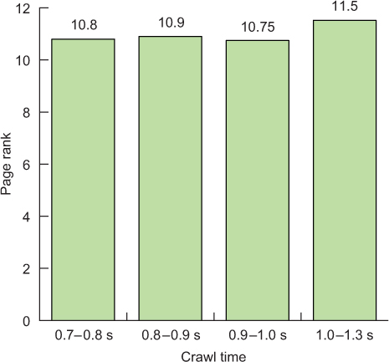
Legendary Tones website
The average rankings of all pages on the Legendary Tones website according to its page download time by Google. Lower values are better.

Slide 8
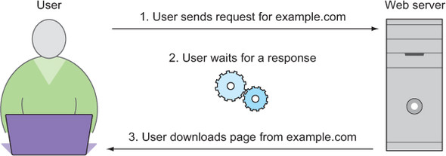
How web browsers talk to web servers
To know why web optimization is necessary, we need to know where the problem lies, and that’s in the basic nature of the way web browsers and web servers communicate.

Slide 9
Cont…
Web performance focuses on making websites load faster, the primary focus is on reducing load time.
The most simple interpretation of load time is the time between the instant a user requests a website and the instant it appears on the user’s screen.
The mechanism driving this is the time it takes for the server’s response to reach the user after the user requests content.
EX: Hypertext Transfer Protocol-- The browser makes an HTTP request, and the web server replies with an HTTP response, which consists of a status code and the requested content.

Slide 10
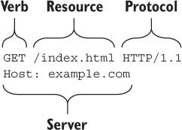
The anatomy of an HTTP request to example.com

Slide 11
latency
“The amount of time spent waiting for a request to reach the web server, the amount of time for the web server to collect and send its response, and the amount of time for the web browser to download the response”.
One of the primary aims of improving performance is to reduce latency, the amount of time it takes for a response to arrive in full.

Slide 12
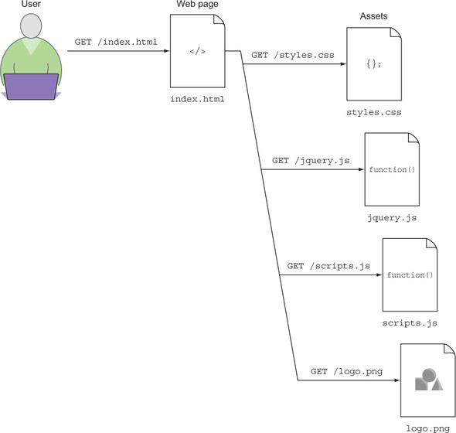
How web pages load

Slide 13
Getting up and running

Slide 14
Performance problems often signify issues in front end architecture.
Some issues can originate from a poorly configured application back end, those issues are specific to those application platforms
Ex: PHP or .NET
Investigate how to fix common performance problems through an interactive exercise that enhances the performance of a client’s single-page website.

Slide 15
We will get the client’s website running on your computer.
To do this, we use Node.js and Git.
Use Google Chrome to simulate a network connection to a remote server so that you can measure the results of your work in a meaningful way.

Slide 16
Installing Node.js and Git
Node.js (informally called Node) is a JavaScript runtime that allows JavaScript to be used outside the browser.
It can be used for numerous things, but in this case we use a small Node program that runs as a local web server for running the client’s website.
We use a couple of Node modules to achieve some optimization goals.
Using Node, we can pull down and run the example websites in a matter of minutes, even if you have little or no experience with Node.

Slide 17
To install Node, go to http://nodejs.org.
In the Download section, find the installer for your operating system.
When running the installer, choose the standard installation option to ensure that the Node Package Manager (npm) installed.
Npm provides access to the vast Node package ecosystem available on http://npmjs.com, and is required to complete the client website exercise.
Need to install Git to pull down the client website

Slide 18
To download Git, head over to https://git-scm.com/downloads, choose the installer for your system, and run it.
After you’ve installed Node and Git, continue on!

Slide 19
Downloading and running the client’s website
we can download the client’s website for this chapter from GitHub.
To do this, download the repository into a folder of your choosing from the command line:
git clone https://github.com/malchata/ch1-coyle.git
cd ch1-coyle
This downloads the exercise files from the repository on GitHub into the current working directory on the command line.
If you don’t have Git installed, or you don’t feel like cloning the repository, you can download the exercise as a zip file at https://github.com/webopt/ch1-coyle and extract it where you like.

Slide 20
After the exercise has been downloaded, you’ll need to use npm to download the packages necessary for the web server to run.
Run the following command in the same folder to download and install the needed packages:
npm install express
Depending on your connection speed, the installation could take 10 or more seconds.
After it finishes, you can run the following command to start the local web server: node http.js

Slide 21
When you run this command, a local web server running the client website will be accessible on your computer at http://localhost:8080 and will appear.
if you have another service running on port 8080, we can open the http.js file in your text editor and change the port number on line 8.
To stop the server from running, press Ctrl-C.

Slide 22
Simulating a network connection
We are running the client’s website on a local machine, no latency occurs when you make requests to localhost.
Without latency, it’s difficult to measure any gains in performance, because no network bottleneck exists in this scenario.
One way to get around this is to deploy the website to a remote web server as you complete the steps.
But this can be convoluted for our purposes.
A better way is to use Google Chrome Developer Tools.

Slide 23
To get started, open Chrome.
To open the Developer Tools on a Windows machine, press F12.
On a Mac, press Command-Alt-I.
The Developer Tools should appear within the Chrome window.
Alternately, you can choose View > Developer > Developer Tools. When the Tools menu appears, click the Network tab that appears at the top of the window.

Slide 24
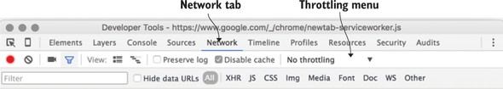
Near the top and to the right of the Disable cache check box is a drop-down menu labeled No throttling.
This is the network throttling menu. When you click it, a list of options appears.
These options allow you to simulate conditions that can be useful for performance testing.
select the Regular 3G profile, which simulates a slower mobile network connection.

Slide 25
When you’re finished optimizing the client’s website,
switch this drop-down menu back to No throttling.
If you forget, all of your web browsing will be throttled to the selected setting while the Developer Tools are open.

Slide 26
Auditing the client’s website
To optimize a website, you have to be able to identify areas of improvement.
This means analyzing the number of requests on a page.
The amount of data the page contains, and the amount of time it takes for the page to load.
How to create waterfall charts with these tools and how to quantify aspects of your client’s website so that you have a starting point for optimizing.

Slide 27
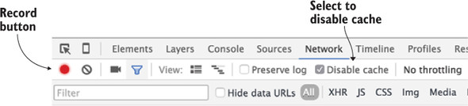
The Record button must be in the enabled state (red) before you can generate a waterfall chart of assets.
The Disable Cache check box should also be selected so that no caching is done when you reload the page to measure the results of your work.

Slide 28
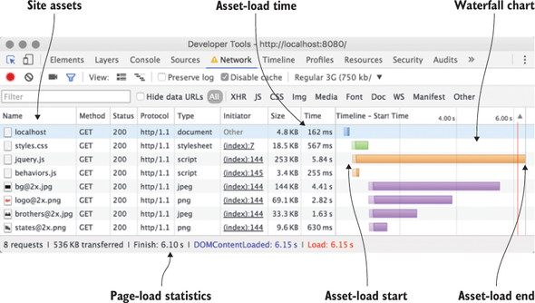
A waterfall chart generated for your client’s website. At the top, you can see the request for index.html, followed by the site’s CSS, JavaScript, and images.
Each bar represents a request for a site asset. The bars are positioned on the x-axis according to the time they began downloading on the left, and the time they have finished downloading on the right.
The length of a bar corresponds to the amount of time it takes for the asset to be requested and downloaded by the web browser.

Slide 29
A comparison of page-load times across various devices. Results vary depending on the amount of data and the display density of the device.
Device type | Display density | Page weight | Load time
Mobile (phone and tablet) | Standard | 378 KB | 4.46 seconds
Mobile (phone and tablet) | High | 526 KB | 6.01 seconds
Desktop | Standard | 383 KB | 4.51 seconds
Desktop | High | 536 KB | 6.15 seconds

Slide 30
Optimizing the client’s website
When improving the performance of a website, the goal is simple:
Reduce the amount of data transferred.
Decrease the amount of time that the site loads on any device.
The best part of this pursuit is that it benefits the user on both HTTP/1 and HTTP/2 servers.
Fewer bytes transferred means faster load times.
Reducing requests can help, and some performance-boosting techniques

Slide 31
In these optimization efforts, we start by minifying the assets of the site, which includes the CSS, the JavaScript, and the HTML.
Then move on to optimize the images on the site without compromising their visual integrity.
Finally, finish by employing compression on the server for text assets.

Slide 32
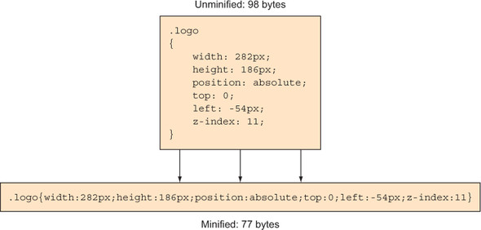
Minifying assets
Minification is a process by which all whitespace and unnecessary characters are stripped from a text-based asset without affecting the way that asset functions.
Minification of a CSS rule. In this example, a CSS rule is minified from 98 bytes down to 77, which represents a 21% reduction. When this concept is applied to all text assets on a site, the reductions can total many kilobytes.

Slide 33
Many human-readable files such as CSS and JavaScript contain whitespace and characters that are inserted by developers during development.
We use line breaks and indentation in our CSS and JavaScript to make them easier to read, as well as using comments in source code for documentation purposes.
Web browsers need no such help when reading these files.
The fewer unnecessary characters that are in these files.
The faster the web browser will download and parse them.

Slide 34
By minifying the site’s CSS, then JavaScript, and finally the HTML.
npm install –g minifier html-minify
Minifying the website’s CSS
By minifying it, Reduce the weight of the page a bit.
To minify the site’s CSS, you need to do two things:
Run the minifier program and then update the HTML to point to the newly minified file.
To minify the CSS, run this command inside the website’s css folder:
minify -o styles.min.css styles.css

Slide 35
Web performance optimization techniques
HTTP requests reduction | Adopt Cloud-based Website Monitoring
File compression | Prefetch and reconnect
Web caching optimization | SSL certificate/ HTTPS
Code minification | Web Font Performance
Lossy compression | Hotlink protection
Replacement of vector graphics | Infrastructure
Image Optimization | 404 Errors
301 Redirects | Database Optimization

Slide 36
HTTP requests reduction
HTTP requests your web page makes the slower it will load.
A browser is limited to opening only a certain number of simultaneous connections to a single host.
To prevent bottlenecks, the number of individual pages elements are reduced using resource consolidation whereby smaller files, such as images, are bundled together into one file.
This reduces HTTP requests and the number of round trips required to load a webpage.
Making fewer HTTP requests turns out to be the most important optimization technique, with the biggest impact.

Slide 37
File compression
Web pages are constructed from code files such JavaScript and HTML. As web pages grow in complexity, so do their code files and subsequently their load times.
File compression can reduce code files by as much as 80%, thereby improving site responsiveness.

Slide 38
Web caching optimization
Web Caching Optimization reduces server load, bandwidth usage, and latency.
CDNs use dedicated web caching software to store copies of documents passing through their system.
Leveraging the browser cache is crucial.
It is recommended to have a max-age of 7 days in such cases.
This saves server time and makes things altogether faster.

Slide 39
Code minification
Code minification distinguishes discrepancies between codes written by web developers and how network elements interpret code.
Minification removes comments and extra spaces as well as crunch variable names in order to minimize code.

Slide 40
Lossy compression
Lossy compression techniques, similar to those used with audio files, remove non-essential header information and lower original image quality on many high-resolution images.
These changes, such as pixel complexity or color gradations, are transparent to the end-user and do not noticeably affect the perception of the image.

Slide 41
Replacement of vector graphics
Replacement of vector graphics with resolution-independent raster graphics.
Raster substitution is best suited for simple geometric images.
Image Optimization
Don’t upload the original photos on your website, they are too heavy.
Use tools like TinyPNG, Kraken.io, JPEGmini, etc, which reduces the size of the image while quality remains more or less the same.

Slide 42
301 Redirects
Redirects are performance killers.
Avoid them whenever possible.
A redirect will generate additional round-trip times and therefore quickly doubles the time that is required to load the initial HTML document before the browser even starts to load other assets.

Slide 43
Adopt Cloud-based Website Monitoring
There are significant advantages to offloading your website monitoring to a cloud-based host,
For example, cost, scalability, efficiency, etc.
Prefetch and reconnect
Domain name prefetching is a good solution to already resolve domain names before a user actually follow a link.

Slide 44
Web Font Performance
The disadvantages of web fonts, such as Google Fonts, are that they add extra HTTP requests to external resources.
Web fonts are also rendered blocking.
To prioritize based on browser support, choose only the styles you need, keep character sets down to a minimum, etc.

Slide 45
Hotlink protection
Hotlink protection refers to restricting HTTP referrers in order to prevent others from embedding your assets on other websites.
Hotlink protection will save you bandwidth by prohibiting other sites from displaying your images.
Infrastructure
Having a fast web host is equally as important as any website performance optimization you could make, as it is the backbone of your site.
Stay away from cheap shared hosting.

Slide 46
404 Errors
Any missing file generates a 404 HTTP error.
Depending upon the platform you are running 404 errors can be quite taxing on your server.
Database Optimization
And last but not least is database optimization.
Whether it is cleaning out old unused tables or creating indexes for faster access there are always things that can be optimized.

Slide 47
Key tools for web performance optimization
Page speed | GTMetrix
Pagelocity | Seositecheckup
Varvy pagespeed Optimization | semrush

Slide 48
Page speed
Google PageSpeed Insights grades both the desktop and mobile site speeds.
This popular testing tool analyzes some of the most important website components; JavaScript, CSS, and Image performance.

Slide 49
GTMetrix
GTMetrix offers a variety of reporting options.
GTmetrix goes into great detail as it checks both PageSpeed and YSlow metrics, assigning your site a grade from F to A.

Slide 50
Pagelocity
On top of analyzing on-page SEO performance, Pagelocity also takes a look at social metrics.
How those are affecting your social visibility, as well as general page speed performance and individual tips on how parts of your site can be optimized for better speeds.

Slide 51
Seositecheckup
Seositecheckup helps you instantly analyze your SEO and web speed issues, understand your competitors’ situation.
Gives you advices on which web performance optimization techniques to use to improve your website in a faster and better way.

Slide 52
Varvy pagespeed Optimization
Varvy Pagespeed Optimization offers reports which are broken into 5 different sections including a resource diagram, css delivery, javascript usage, page speed issues found, and services used.
Varvy gives you key web performance optimization techniques to boost web speed and SEO rankings.
SEO stands for search engine optimization, which is a set of practices designed to improve the appearance and positioning of web pages in organic search results.
Because organic search is the most prominent way for people to discover and access online content, a good SEO strategy is essential for improving the quality and quantity of traffic to your website.

Slide 53
Semrush
It is a paid option, but absolutely worth this money! They have different plans.
But even with the most basic one you get enough information to boost your web performance.

Slide 54
Using server compression

Slide 55
Optimizing images

Slide 56
Performing the final weigh-in

